Slide 1
Introductory Programming Techniques
North Metropolitan TAFE
ICTPRG302, MEM30012: Session 8
Certificate IV in IT (Data Science and AI)

Slide 2
What will I learn?
Python collection types, continued
More statistics: variances, standard deviations
Dictionaries: revise how to store data in key-value pairs
Dictionaries: learn how to loop through keys, values and key-value pairs.
Use built-in functions: get(), keys(), values(), items(), etc.

Slide 3
To complete this week
Weekly session exercises
Portfolio questions
Revision…practice, practice, practice!
Simulation project—make some features!

Slide 4
Revision: Lists
What can you remember? True or False?
Lists in Python can contain different data types.
Notes:
True.

Slide 5
Revision: Lists
What can you remember? True or False?
The append() method adds an item to the beginning of a list.
Notes:
False: It adds an item to the end of the list.

Slide 6
Revision: Lists
What can you remember? True or False?
Lists are immutable in Python.
Notes:
False: Lists are mutable.

Slide 7
Additional resources
Online courses, to enhance your knowledge.
Python for Everyone (Py4e)
LearnPython.org
W3schools
Numeracy tutorials

Slide 8
What is a Python Dictionary?
A Python dictionary is a
built-in data type that allows you to store and manage data in key-value pairs.

Slide 9
Two Types of Collections
List:
A linear collection of values that stay in order
best for ordered collections of items.
Dictionary:
A "bag" of values, each with its own label.
best for collections of key-value pairs where each key is unique and used to access its corresponding value.
Depending on which version of Python you’re on (3.7+), dictionaries might also stay in order.

Slide 10
List vs Dictionary
Ordered
Indexed
Mutable
Lists can contain items of the same type or different types
Syntax: Use square brackets []

Slide 11
Dictionary vs List
Ordered (since Python version 3.7)
Key-Value Pairs
Each key in a dictionary must be unique
Mutable
Keys and values can be of different types
Dictionaries are defined using curly braces { }

Slide 12
Keys and Value
A key-value pair consists of two elements:
A key, which is a unique identifier, and;
A value, the data associated with the key.

Slide 13
Key-value Pairs
Keys must be immutable* types like:
strings
numbers, or;
tuples
Values can be of any data type.
*: This isn’t remotely true. But things can get weird if you’re not careful with mutable types.

Slide 14
Creating a Dictionary
Task | Code
Create an empty dictionary | #dictionary_name = {} or #dictionary_name = dict() names = {} or names = dict()
Add a value pair | #dictionary_name[key] = value names[name] = 1
Add one to an existing record | #dictionary_name[key] = dictionary_name[key] + 1 names[name] = names[name] + 1
Print a dictionary | #print(dictionary_name) print(names)

Slide 15
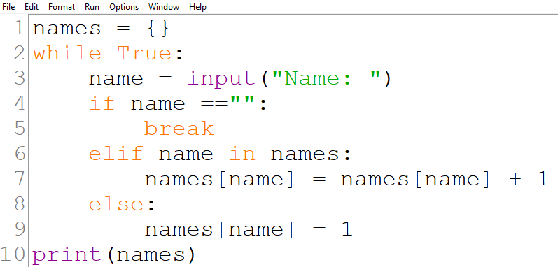
Creating a Dictionary
Create a Dictionary: names = {}
Enter names until only enter is pressed.
If name exists, the value will be plus one, else create a new record and the value is 1. Tip: to know if it exists - if name in names
Print the dictionary

Slide 16
Accessing Values
Values can be accessed by...
1. Using keys: Example: student = {"name": "Olivia", "age": 21, "Unit": "Python"} name = student["name"] print(name)
Olivia # Output

Slide 17
Accessing Values
2. Using the get() method: Example:
student = {"name": "Olivia", "age": 21, "Unit": "Python"} age = student.get("age") print(age) 21 # Output grade = student.get("grade") print(grade)
None # Output

Slide 18
More about the get() method
Avoid a KeyError by using the get() method.
The get method:
checks if a key is in a dictionary
it assumes a default value if the key is not there
dictionary_name.get(keyname, default)
default: what the value will be if the keyname does not exist.

Slide 19
Get Method Example
Description | Code | Output
KeyError if the specific record does not exist. | print(names["John"]) | Traceback (most recent call last): File "C:\Dictionary.py", line 11, in <module> print(names[“John"]) KeyError: ‘John'
get() method | #Value: if the value that you want to use if #the key does not exist in the dictionary dictionary_name.get(key, value)

Slide 20
Let’s code!

Slide 21
Accessing Values
Syntax:
student = {"name": "Alex", "age": 21} name = student["name"] print(name)
Output:
Alex

Slide 22
Accessing Values
Syntax:
student = {"name": "Alex", "age": 21} name = student.get("name") print(name)
# Using the get() method, which returns None or a default value if the key is not found.
grade = student.get("grade") print(grade)
Output:
Alex
None

Slide 23
Modifying Dictionaries
Syntax:
student = {"name": "Alex", "age": 21} student["unit"] = "Python" # add item to the dictionary
print(student)
Output:
{'name': 'Alex', 'age': 21, 'unit': 'Python'}

Slide 24
Updating Dictionaries
Syntax:
# Update the value associated with an existing key.
student = {"name": "Alex", "age": 21, "unit":"Python"}
student["age"] = 22
print(student)
Output:
{'name': 'Alex', 'age': 22, 'unit': 'Python'}

Slide 25
Deleting Dictionaries
Syntax:
# Remove key-value pairs using the del statement.
student = {"name": "Alex", "age": 21, "unit":"Python"}
del student["age"]
print(student)
Output:
{'name': 'Alex', 'unit': 'Python'}

Slide 26
Clearing a Dictionary
Syntax:
# Remove all key-value pairs using the clear() method.
student = {"name": "Alex", "unit":"Python"}
student.clear()
print(student)
Output:
{ }

Slide 27
Dictionary Methods
Syntax:
# get(). Retrieves a value by key, with an optional default if the key is not found.
student = {"age": 22}
name = student.get("name", "Not found")
print(name)
Output:
Not found

Slide 28
Dictionary Methods
Syntax:
# keys(). Retrieves a list of all keys in the dictionary.
student = {"name": "Alex", "age": 22}
keys = student.keys() print(keys)
Output:
dict_keys(['name', 'age'])

Slide 29
Dictionary Methods
Syntax:
# values(). Retrieves a list of all values in the dictionary.
student = {"name": "Alex", "age": 22}
values = student.values() print(values)
Output:
dict_values(['Alex', '22'])

Slide 30
Dictionary Methods
Syntax:
# items(). Retrieves a list of all key-value pairs in the dictionary.
student = {"name": "Alex", "age": 22}
items = student.items() print(items)
Output:
dict_items([('name', 'Alex'), ('age', 21)])

Slide 31
Dictionary Methods
Description | Code
 | names= {"Charlotte": 17, "Olivia": 19, "Alex": 22}
Loop over keys and values | for name in names: print(name, names[name])
Printing the key-value pairs | print(names.items())
Printing a list of keys | print(names.keys())
Printing a list of values | print(list(names))
Printing the values of all the keys | print(names.values())

Slide 32
Iterating through Dictionaries
Syntax:
# Loop through the keys of a dictionary.
student = {"name": "Alex", "age": 22}
for key in student.keys(): print(key)
Output:
name
age

Slide 33
Iterating through Dictionaries
Syntax:
# Loop through the values of a dictionary.
student = {"name": "Alex", "age": 22}
for value in student.values(): print(value)
Output:
Alex
22

Slide 34
Iterating through Dictionaries
Syntax:
# Loop through key-value pairs using the items() method.
student = {"name": "Alex", "age": 22}
for key, value in student.items(): print(key, value)
Output:
name Alex
age 22

Slide 35

Oh noes!!!! MATH!!!!
Image Source: https://resizing.flixster.com/wwVaSr-v1ywol32xq4H8R0tkNKE=/ems.cHJkLWVtcy1hc3NldHMvbW92aWVzLzlkMzAzN2VlLWYyMGYtNDU4ZC05NWE4LWQ2NTAyNzU4NmQ2Yy5qcGc=

Slide 36
Revision: Data Series
Mean
Mode
Median

Slide 37
Dispersion Measures
Range
Inter-quartile range
Standard Deviation
A | B
99 | 0
100 | 100
101 | 200
A & B have the same mean and median, but very different distributions!

Slide 38
Range
A set’s range is the difference between its smallest and largest elements.
Pretty easy! And not super informative.
A | B
1 | 1
5 | 22
10 | 23
15 | 24
20 | 25
25 | 26
30 | 30

Slide 39
Inter-quartile range
This is the range of the middle 50% of values.
IQR = Q₃ - Q₁
Find the IQR for this series of wages?
$20, $31, $10, $21, $11, $19, $36, $9

Slide 40
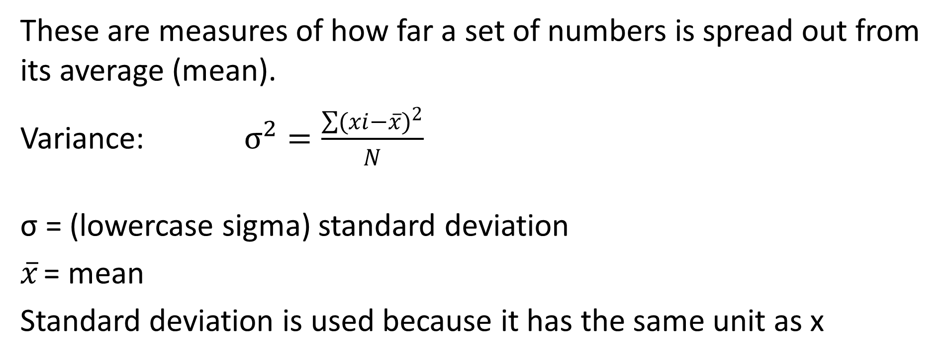
Variance and Standard Deviation
These are measures of how far a set of numbers is spread out from its average (mean).
Variance: $σ^{2}=\frac{\sum{{(xi−\overline{x})}^{2}}}{N}$
σ = (lowercase sigma) standard deviation
$\overline{x}$ = mean
Standard deviation is used because it has the same unit as x

Slide 41
Exercise
We could find the std.dev. of some example data set.
But let’s code it.

Slide 42
PEP8 Standards
Use 4 spaces per indentation level
If spanning multiple lines, align the elements vertically
If the dictionary is small, it can be defined on a single line
Use hanging indents for dictionaries that span multiple lines.

Slide 43
Best Practices: Dictionaries
Choose keys that clearly describe the associated values
Use immutable types (like strings, numbers) as keys
Use the get() method to check if a key exists.

Slide 44
Summary
Creating dictionaries
Using dictionaries
Accessing dictionaries
Modifying dictionaries
Methods: get(), keys(), values(), items()
More PEP8 standards.

Slide 45
Activities to complete
Practise what you have learnt today!
Go to your Week 8 Revision Exercises folder and complete the revision activities.

